Slide 1

Java Chat Application
Team:-
Tumati Omkar Chowdary (188)
Akula Satya Sesha Sai (168)
Palameti Reddy Lakshmi Manoj (179)

Slide 2

Introduction to Real-Time Communication with Java Chat App
Experience the power of instant, real-time communication with our innovative Java chat application. Connect with friends, family, and colleagues from anywhere in the world, breaking the barriers of distance and time zones. Our Java chat app provides a secure and reliable platform for seamless conversations, ensuring your privacy. Discover the convenience and efficiency of real-time communication with our cutting-edge Java chat app.

Slide 3
Abstract: Exploring the Core Concepts of Java Chat Application
Delve into the abstract world of Java chat application development as we unravel its core concepts and functionalities. From understanding the client-server architecture to implementing efficient network programming techniques, this card provides an in-depth overview of the key components that make a Java chat app successful. Discover the intricacies of handling multiple clients, ensuring secure communication, and optimizing performance. Join us on this journey of exploring the abstract aspects of Java chat application development.

Slide 4

The Motivation for Building a Java Chat App
1
Ease of Use
A Java chat app provides a user-friendly interface for communicating with others efficiently.
2
Safe and Secure
Unlike various social messaging apps on the internet that compromise with their clients’ privacy, Java chat protects customer privacy and keeps their personal data secure and private.
3
Saving Time and Effort
Java chat apps allow people to communicate with each other without having to travel to see one another, saving both time and effort.

Slide 5
The Objective of Java Chat Application
Real-time Communication
Highlighting Quality
The primary objective of this application is to achieve real-time communication between two or more clients.
The app aims to provide the optimal quality of text chat options.
User-friendly Interface
High Security
The app aims to provide a user-friendly and minimalist interface.
The chat app strives to protect the personal data of its users, making security and privacy the top priority.

Slide 6

The Problem with Existing Chat Applications
1
Poor User Experience
Several chat applications suffer from a poor user experience, making it challenging for users to navigate through the application.
2
Insecurity and Privacy Concerns
Many chat applications have a bad reputation for compromising user data security and privacy.
3
Limited Customization
Existing applications usually offer limited customization options. Often, users are frustrated by the app's inability to personalize based on their preferences.

Slide 7
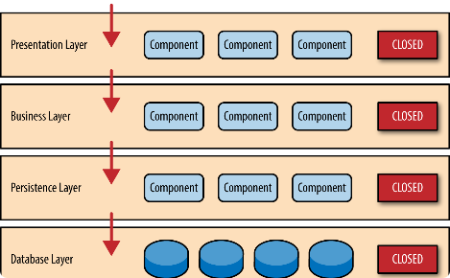
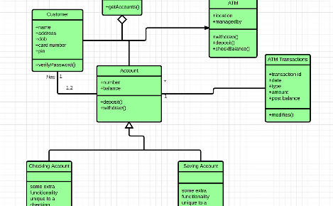
Designing and Architecting a Chat Application
Software Architecture
Class Diagram
Designing a functional software architecture plays a critical role while building a chat application. It includes building models and frameworks with high-level descriptions of the system runtime processes.
A class diagram represents a visual representation of an application design and abstraction of different objects or classes.

Slide 8
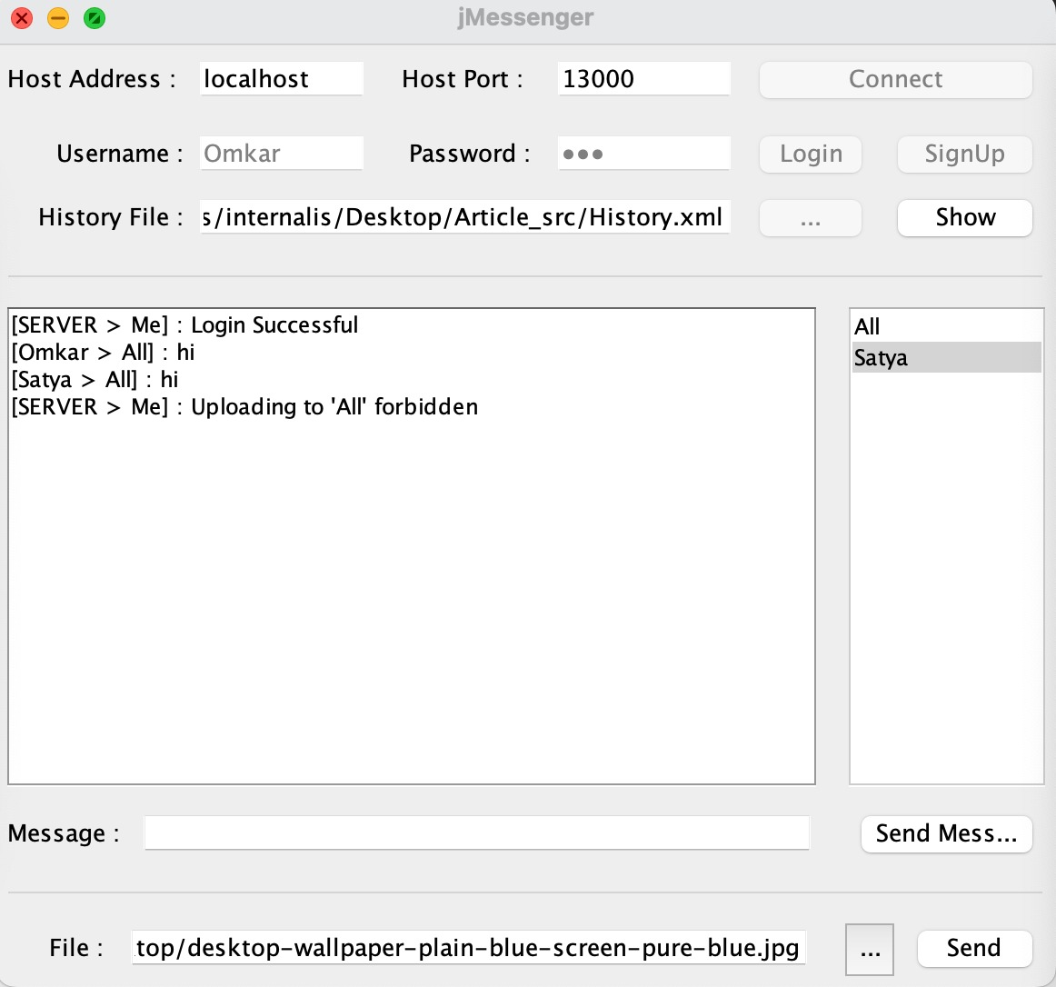
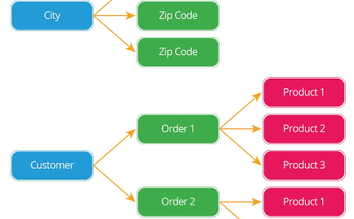
User Interface
Database Relationship
The user interface provides the connection between the client and the application. Creating an interface that's neat, user-friendly, and aesthetically pleasing is crucial for client satisfaction.
The database stores essential chat data that includes user identity, messages, and sessions. It requires a robust and secure relationship that enables seamless communication within the app.

Slide 9
The Role of Sockets and Network Programming
Sockets
Network Programming
Java sockets allow the user program to communicate over various network protocols and communication mechanisms. They enable users to communicate between two endpoints and provide seamless connectivity.
Java Network Programming provides the building blocks to create network applications and support socket-based communication protocols. With increased programming functionalities, the developer can provide better functionality, security, and scalability.

Slide 10

Client-Server Communication
1
Connecting Clients to Server
A client sends a request to the server using a socket to connect to the server socket on the server-side. The server-side listens for an incoming client and accepts the connection.
2
Implementing Sender and Receiver Functionality
When the client successfully connects to the server, two threads get initiated - one for the sender and one for the receiver. The sender thread captures the message from the client-side and passes it to the server for broadcasting to other clients. The receiver thread collects server messages and passes them on to the client-side for display.
3
Disconnecting the Client
The client and server close the connection by sending termination messages and releasing the occupied resources.

Slide 11
Handling Multiple Clients
Developments in Technology
Client and Server Architecture
With advancements in cloud technology, clients can be added with ease, which readily enhances project scalability.
The client-server architecture handles multiple clients through its access points. The server's ability to handle multiple client requests simultaneously enhances the usability of the java chat application.
Load Balancing
Server Virtualization
The load balancer distributes the client requests among several servers, enhancing scalability, optimized resource utilization, and improved communication reliability.
Server virtualization allows you to deploy multiple servers across a cluster or a single server, enhancing application performance, scalability, and resource optimization.

Slide 12



Conclusion and Next Steps
Success is Possible
Upgrade and Expansion
Exploring Other Communication Technologies
Creating an optimized chat application is possible with the right design, architectural specifications, and skilled programming.
Routinely upgrading existing code, adding or enlarging the features of the chat app, and research can aid in enhancing it and staying ahead of the curve.
Exploring available communication technologies and integrating them into the chat app can enhance the app's functionality, growth and keep users engaged.

